Slide 1
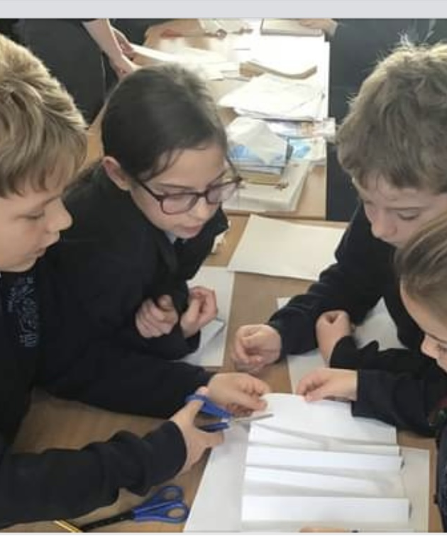
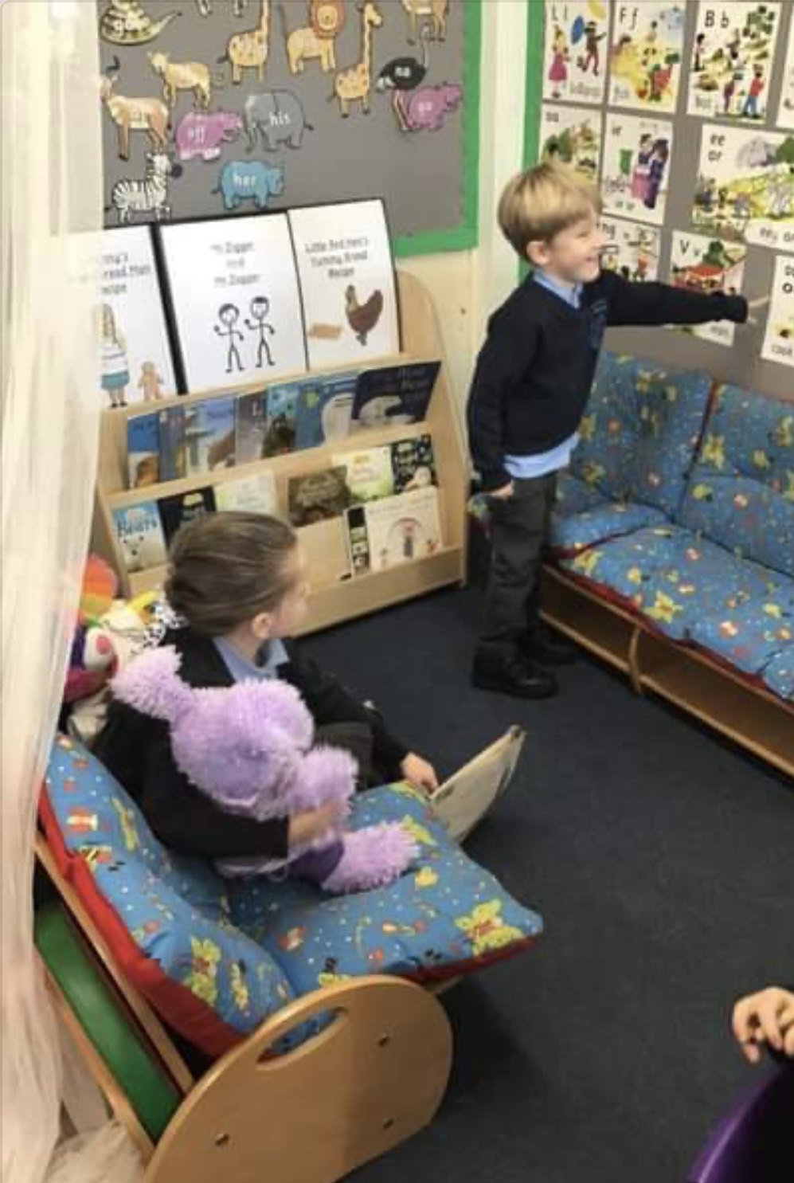
Behaviour Partnership Tuesday 25th January 2022

Slide 2
Thank you for joining us: together we would like…
To share our behaviour policy with you
To celebrate the relationships within the school
To work with you to promote the highest standards of behaviour
To rebuild some of the social skills children lost through lockdown

Slide 3
Our core belief – Our practice is always trauma-informed and inclusive .
We believe that all children are inherently good. We set the children up to succeed.
We believe that conflict is best resolved through talking and teaching rather than punishment
We want the children to gain deep understanding of their own behaviour and we recognise that this is a slow process.
We model the behaviour we would like to see in the pupils and our responses are always child-centred.

Slide 4
What does our recent RE Inspection Report say?
The school’s unique Behaviour Policy, which seeks to ‘guide children to their intrinsic sense of respect for self and others’ inspires great understanding of social justice and a desire to ‘right wrongs’ in all its pupils
High standards of behaviour and the quality of relationships within the school community are real strengths of the school and pupils feel safe to be themselves and thrive in a community where they are encouraged to be confident, curious, autonomous individuals who are ready to take their place and contribute to society.

Slide 5
What do the children say?
“When I make a mistake, my teachers let me have my side of the story and it teaches me to respect and it lets me be okay with making mistakes. Other schools have punishments which they use even if children make a mistake, which to me would make me afraid to make a mistake and to learn from it.”

Slide 6
What we notice post lockdown…
Increase in: Decrease in:
Tiredness Fitness
Gaming Awareness of the world
Swearing Manners
Anxiety Lack of collaboration

Slide 7
What we are doing…
Increase playground games and activities
KS1 MY-CATS
ELSA
PSHE
Extra Physical activity
Talking more…

Slide 8
Behaviour in practice in EYFS
We start to build intrinsic motivation and self-regulation; the bedrock of our policy
Sharing, turn taking, recognising emotions and tolerating others

Slide 9
What do the children say?
“I like it when the teachers sort things out with us and do circle time to chat about our troubles. We sort it out together.”

Slide 10
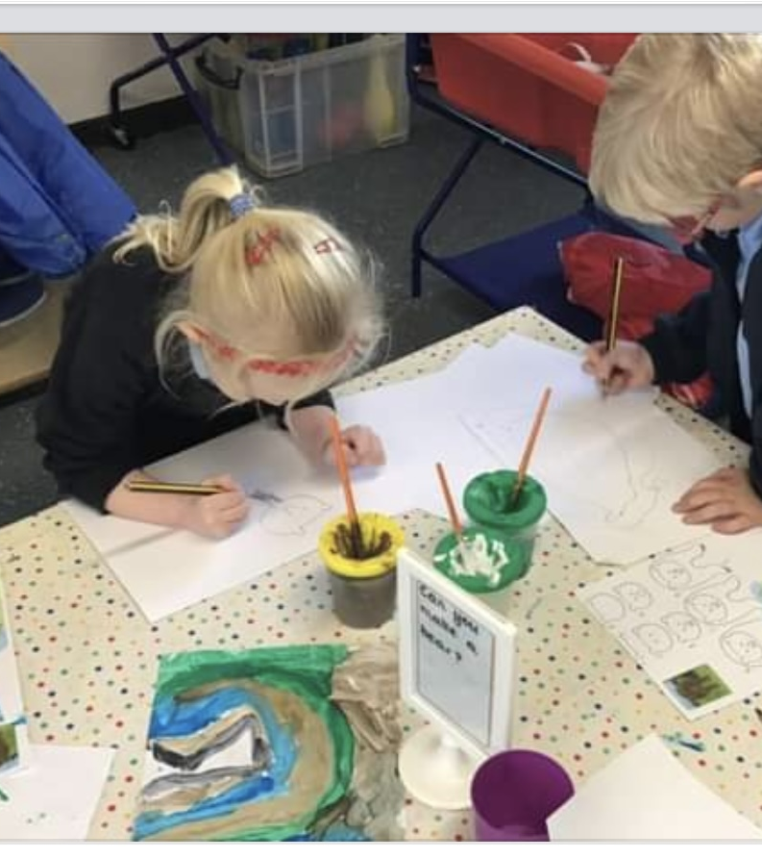
‘Behaviour for learning is outstanding in most lessons; pupils work with enthusiasm and concentration and are rarely off task.’

Slide 11
We use Clean questions
What happened?
What happened just before?
What would you like to have happen now?
Is it possible?
Is there anything else?
‘Clean’ David Grove

Slide 12
Behaviour in practice in KS1
Clean questions
Change of place within the classroom.
Removal from the group or classroom for a few seconds to enable reflection.
No-cost techniques focus on creating a successful resolution to a problem rather than controlling a situation through punishment or humiliation.
Encouraging the children to think of people in the wider world.

Slide 13
The unique Behaviour Policy of the school, with redemption and reconciliation at its core, promotes pupils’ understanding of social justice and instils in all, a desire to ‘right wrongs,’ and support others in making right decisions – as one pupil said: ‘I think this school is good because instead of punishing us, the teachers try to see everyone’s point of view which makes you want to respect them because they respect you’.

Slide 14
Behaviour in practice in Lower Key Stage 2
A period of transition.
Friendships are becoming more intense.
Children are asserting their independence and experimenting with different behaviours. This is where we notice the widest range of behaviours.
Wide range of maturity
Children at this age may frequently regress in every area of social development.
Our approach remains consistent and trauma informed. We guide the children towards self-regulation without the use of punishments.

Slide 15
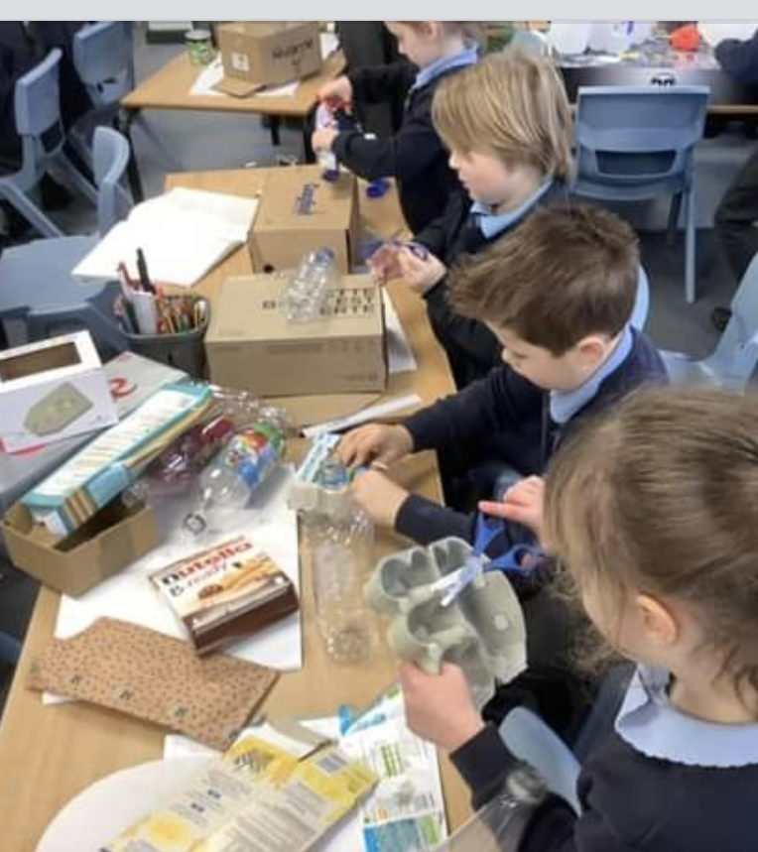
The Behaviour Policy… ‘is firmly rooted in Gospel Values and helps their children to form strong, respectful relationships at all levels and helps to prepare them to take their place in society’

Slide 16
What do the children say?
“I think this school is good because instead of punishing us the teachers try to see everyone’s point of view which makes you want to respect them because they respect you. If we were punished, we would be angry with the teachers so we would do it again. We are allowed to make mistakes because we learn from them, and we are not going to get told off.”

Slide 17
Behaviour in practice in Upper Key Stage 2
Children are expected to complete tasks and are guided to find the best way to engage fully in their learning.
Coaching – looking at what is wanted, why that is wanted and how the child can best be supported in achieving this, with the resources available.
Self-image and peer pressure – exposure to social media that is beyond their chronological age
Status and popularity
Gaming – time consuming, age limits

Slide 18
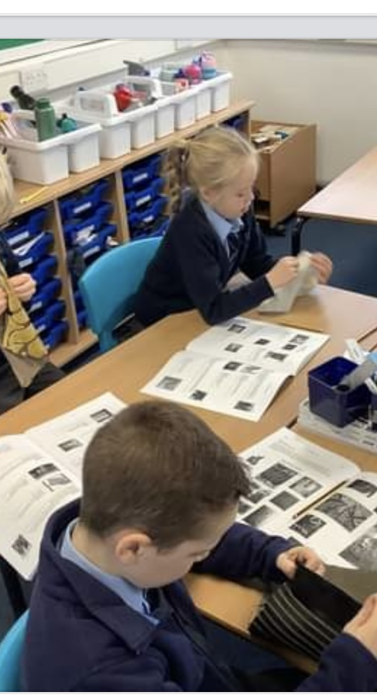
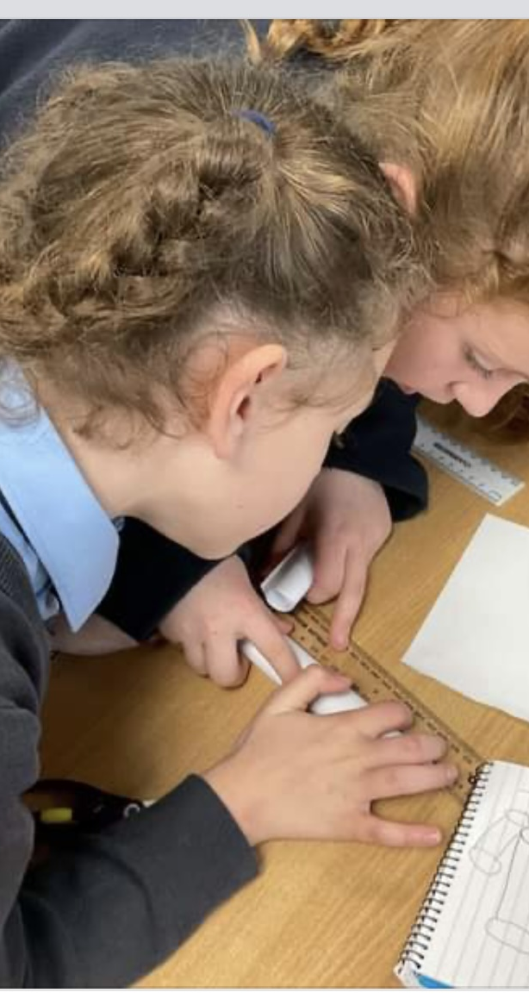
'The behaviour of pupils is exemplary; they take responsibility for their actions, and they understand the high expectations all adults have of them and the importance of making good choices.’

Slide 19
It takes a village to raise a child…

