Slide 1
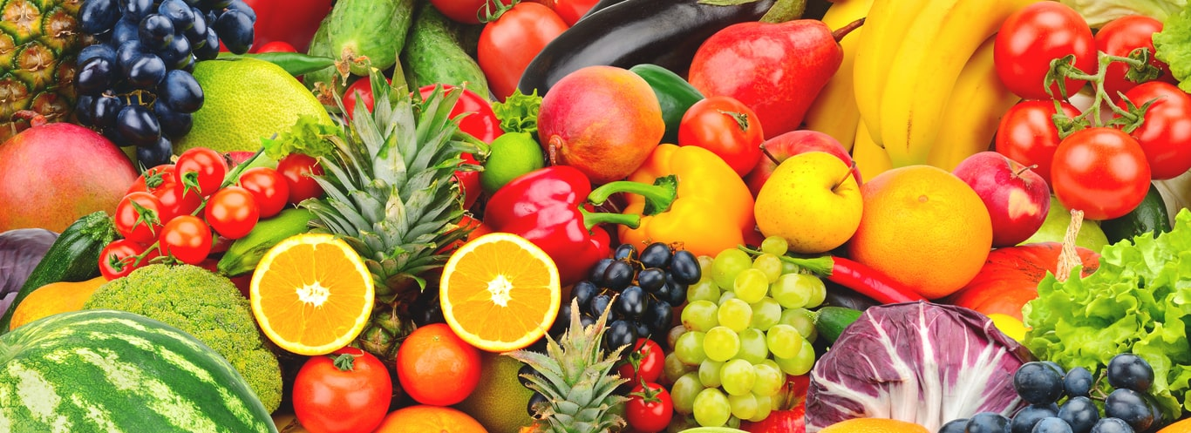
Healthy Lifestyles
January 2022

Slide 2
So what’s the purpose?
Government drive– ‘Empower adults and children to live healthier lives.’
We want our children to have a positive body image
We want our children to have a positive view of food and physical activity
Year Group | Healthy weight | Overweight | Obese (inc severely obese) | Severely Obese
F2 | 71.3% | 13.3% | 14.4% | 4.7%
Year 6 | 57.8% | 15.4% | 25.5% | 6.3%

Slide 3
What do we notice?
Good awareness of the importance of physical activity
Children have a good knowledge of how the body works and are able to talk about their bodies using the correct terminology
Children know the names of lots of foods
Children are increasingly aware of different cultures

Slide 4
What do we notice?
Children are tired
Fitness has deteriorated post-lockdown
Children eating sweets on site
Children say they are starving!

Slide 5
What we do…
Several breaks in day
Physically active
Skipping John, Flat Stan, Street Runs
Emotional literacy support - ELSA
Wellbeing lessons
PE includes learning about the physiology and anatomy of the human body

Slide 6
What we do…
Food and nutrition teaching
Food tasting
Cooking and cookery club
DT – cooking skills progressive throughout the school
Wellbeing week
Using the outdoor spaces daily

Slide 7
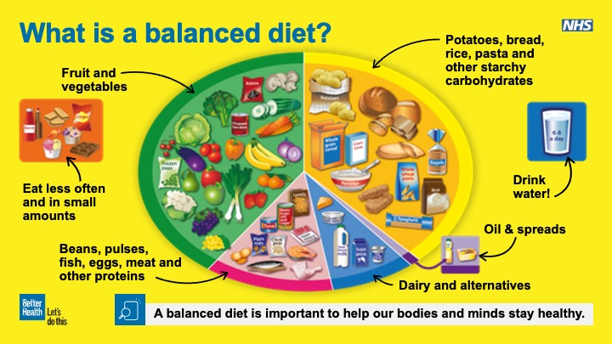

Slide 8
Did you know?
Sugar allowance for a up to age 7 is just 19g per day!
Sugar allowance for an older child is just 25g per day!
Many of our children will have had this for breakfast

Slide 9
Packed Lunch Survey
35% had no fruit or vegetables
52% contained a chocolate bar/cake
42% contained crisps
Only 32% of those with a drink had water
7% contained nuts (a huge risk to other pupils)
Ham sandwich on white bread
Crisps
Apple
Chocolate biscuit/cake
Frube yoghurt
Cordial Drink
The average packed lunch looked like this…
Most lunches had more than their entire daily sugar allowance and children were still hungry!

Slide 10
School Meals
All school meals are subject to meeting very strict guidelines set by ‘Food Based Standards’ 2005
Certain food groups are limited
Portions are very carefully measured for all children
We encourage children to try different things

Slide 11
Can you help us to improve?
We want to set the children up for a healthy life and it starts in school
We would like to become a ‘sweet free’ zone
Can we make our packed lunches as healthy as our school lunches?
We want to improve wellbeing by increasing enjoyment of physical activity
Can we promote mindfulness and outdoor activity?
LET’S GET TALKING!

Slide 12
Useful links
NHS Food Scanner – Free to download - Suggests ‘healthy swaps’
Wirral mental health support team – see school website for links

