Slide 1
Phonics Meeting
What would you like to know?

Slide 2
Phonics Screening
The screening is usually the second week of June TBC – extra effort now will make a big difference
40 words – 20 real and 20 ‘alien’ words
Done with class teacher
Anticipated pass mark to be around 35 out of 40
Able to re-sit in Y2

Slide 3
What can be done at home?
Read to and with your children daily. We recommend at least fifteen minutes.
Phonics keyrings must be looked at daily. Encourage the children read out loud. Put words with this sound. DO NOT ask the children to think of their own words as it could result in misconceptions. E.g. “ow” making the middle sound in “loud”.

Slide 4
Reading Books
Each week, your child will be given two reading books
  One is to develop their phonetic knowledge and application
  One is to practise/rehearse their knowledge and continue to build their fluency
  If your child is struggling to identify a specific sound, stop and work on this before proceeding

Slide 5
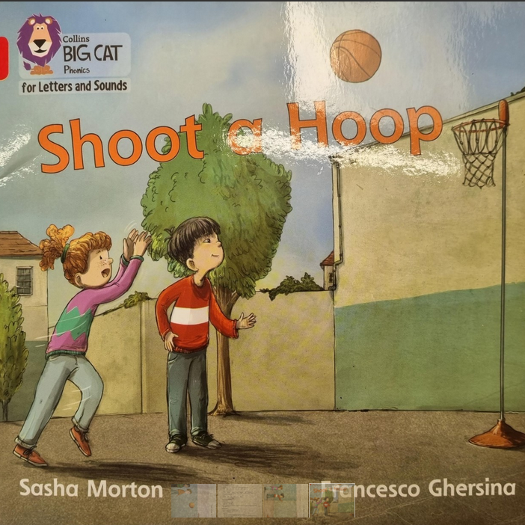

Slide 6
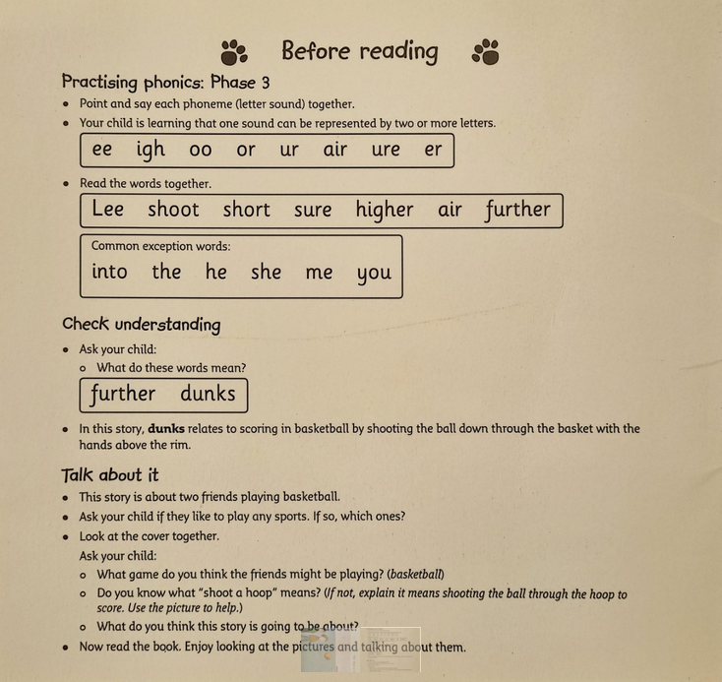

Slide 7
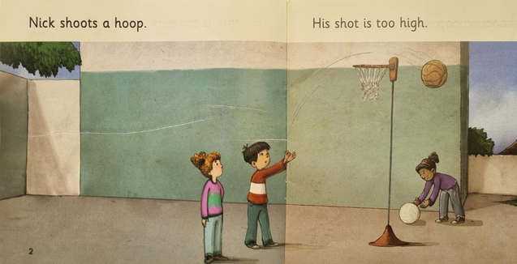

Slide 8
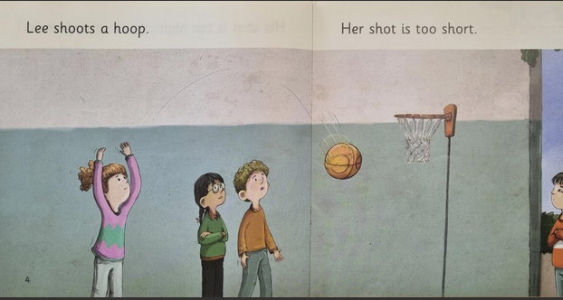

Slide 9
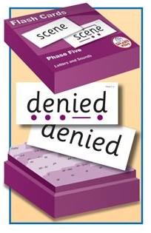
Phonics flash cards
Amazon – around £30
Kindle app for phonics screening test - £3
Websites: Oxford Owl, Phonics Play and Top Marks

Slide 10
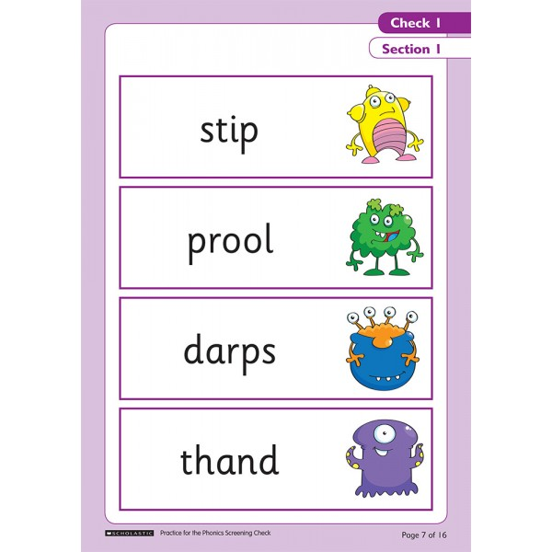
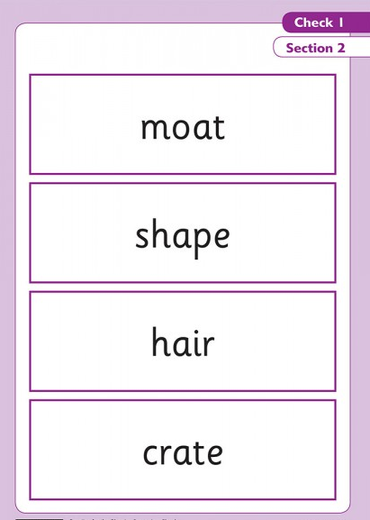
Example test papers
This is an example of a paper that will be sent out closer to the Phonics Screening test.
Alien words are clearly defined through the pictures to the right.

Slide 11
Helping your child to read words
Read sounds from left to right
Recognising diagraphs
phone

Slide 12
might

Slide 13
made

Slide 14
shining00

Slide 15
tirl

Slide 16
flouter

Slide 17
snoof

Slide 18
Alternative sounds
ea treat head
ow crown blow
ear bear fear
Alien words – either pronunciation can be accepted
trower/creat

Slide 19
Practising at Home…
Read phonics keyring as well as any books you have daily. Short but frequent sessions are much better.
Take children’s last answer – getting children in to the habit of sounding out and then saying the whole word blended.
No pressure on children – we say they will just read some words to us.

Slide 20
https://www.youtube.com/watch?v=IPJ_ZEBh1Bk
0.40-3.48

Slide 21
Any questions?

